Slide 1

Chapter 3
Data and Signals
3.1
Copyright © The McGraw-Hill Companies, Inc. Permission required for reproduction or display.

Slide 2

Note
To be transmitted, data must be transformed to electromagnetic signals.
3.2

Slide 3





3-1 ANALOG AND DIGITAL
Data can be analog or digital. The term analog data refers to information that is continuous; digital data refers to information that has discrete states. Analog data take on continuous values. Digital data take on discrete values.
Topics discussed in this section:
Analog and Digital Data Analog and Digital Signals Periodic and Nonperiodic Signals
3.3

Slide 4
Note
Data can be analog or digital. Analog data are continuous and take continuous values.
Digital data have discrete states and take discrete values.
3.4

Slide 5




Note
Signals can be analog or digital. Analog signals can have an infinite number of values in a range; digital signals can have only a limited number of values.
3.5

Slide 6
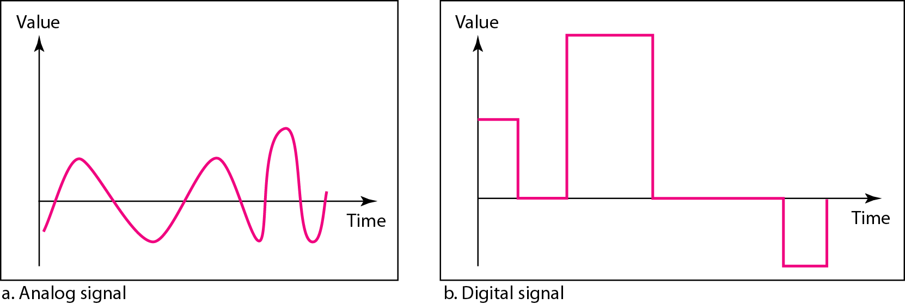
Figure 3.1 Comparison of analog and digital signals
3.6

Slide 7

Note
In data communications, we commonly use periodic analog signals and nonperiodic digital signals.
3.7

Slide 8




3-2 PERIODIC ANALOG SIGNALS
Periodic analog signals can be classified as simple or composite. A simple periodic analog signal, a sine wave, cannot be decomposed into simpler signals. A composite
periodic analog signal is composed of multiple sine waves.
Topics discussed in this section:
Sine Wave Wavelength Time and Frequency Domain Composite Signals
Bandwidth
3.8

Slide 9
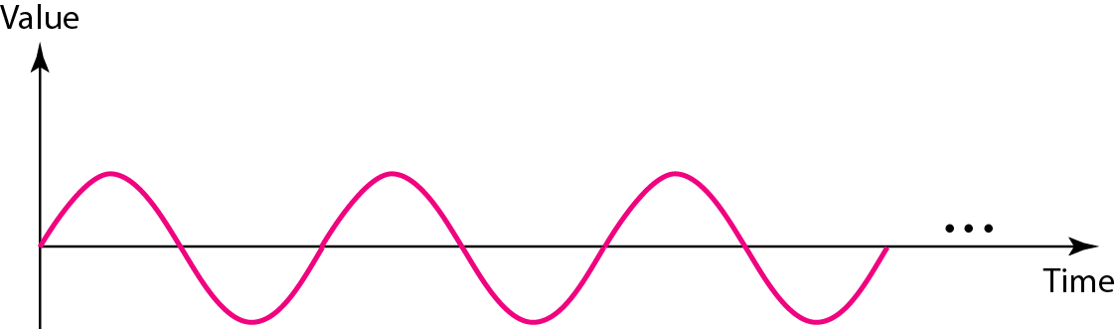
Figure 3.2 A sine wave
3.9

Slide 10
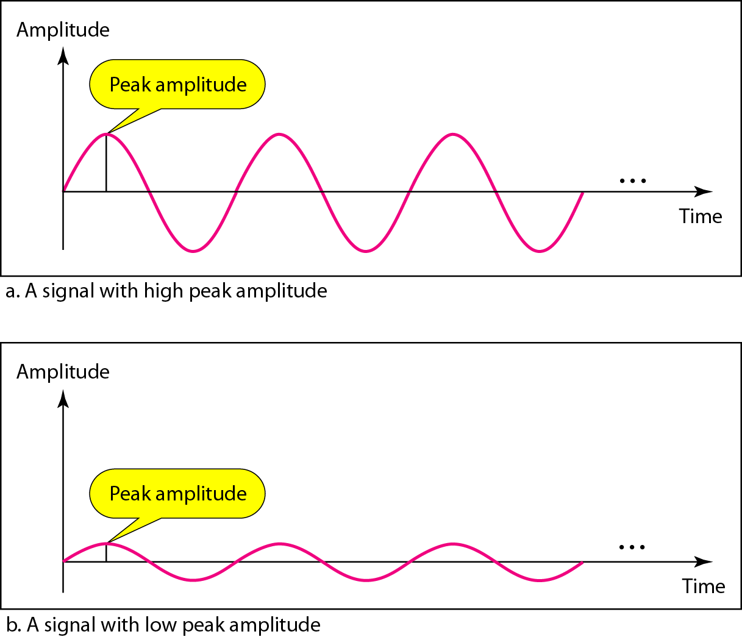
Figure 3.3 Two signals with the same phase and frequency, but different amplitudes
3.10

Slide 11

Note
Frequency and period are the inverse of each other.
3.11

Slide 12
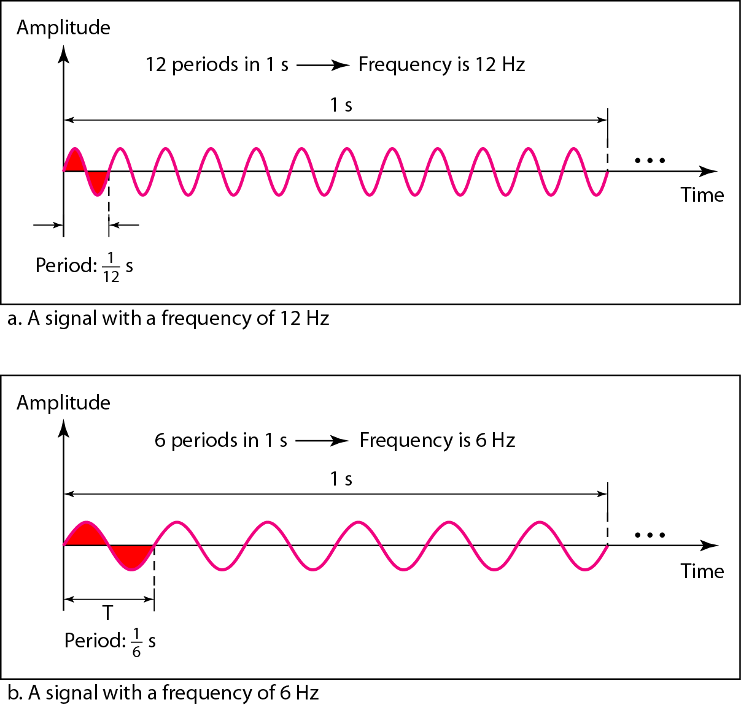
Figure 3.4 Two signals with the same amplitude and phase, but different frequencies
3.12

Slide 13
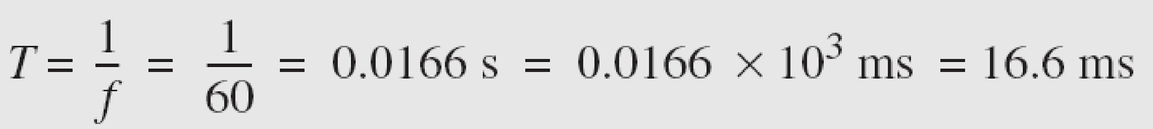

Example 3.3
The power we use at home has a frequency of 60 Hz. The period of this sine wave can be determined as follows:
3.13

Slide 14
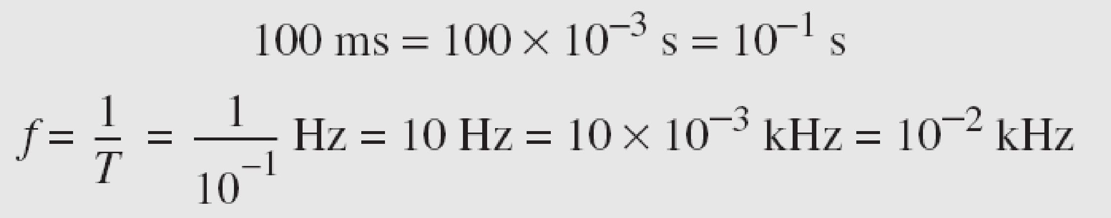
Example 3.5
The period of a signal is 100 ms. What is its frequency in kilohertz?
Solution
First we change 100 ms to seconds, and then we calculate the frequency from the period (1 Hz = 10⁻³ kHz).
3.14

Slide 15

Note
Frequency is the rate of change with respect to time. Change in a short span of time
means high frequency. Change over a long span of time means low frequency.
3.15

Slide 16
Note
If a signal does not change at all, its frequency is zero.
If a signal changes instantaneously, its frequency is infinite.
3.16

Slide 17
Note
Phase describes the position of the waveform relative to time 0.
3.17

Slide 18
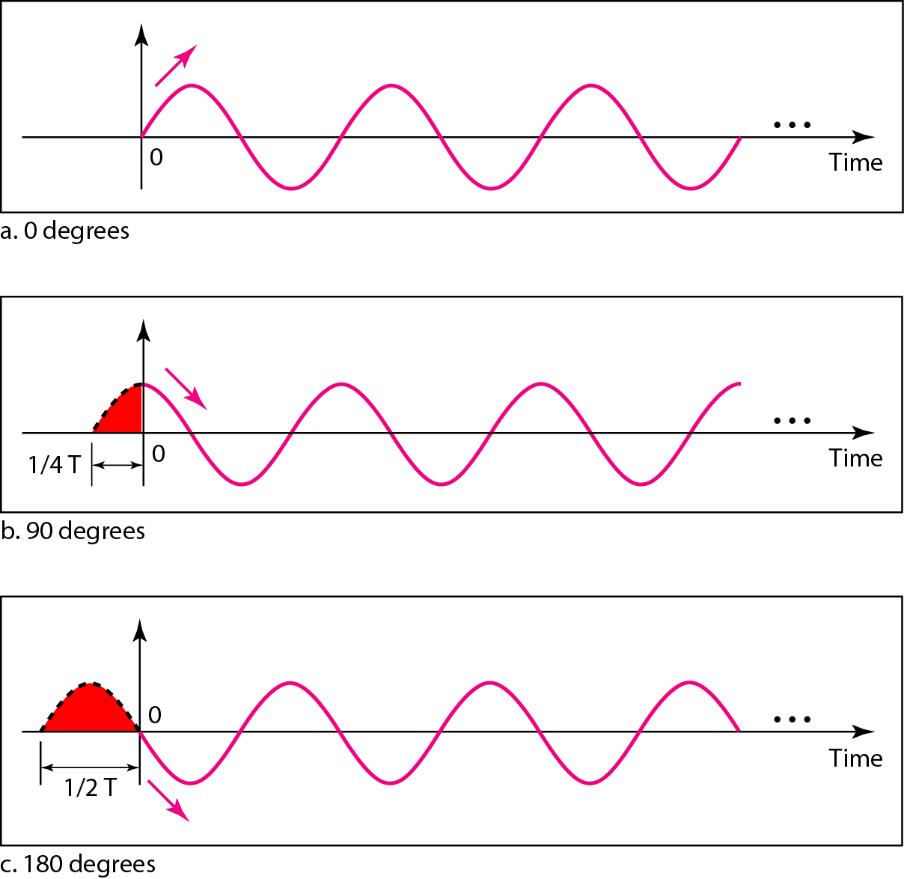
Figure 3.5 Three sine waves with the same amplitude and frequency, but different phases
3.18

Slide 19
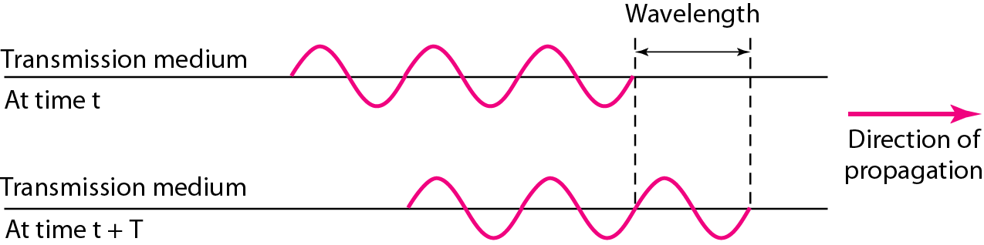
Figure 3.6 Wavelength and period
3.19

Slide 20
Time domain and frequency domain
3.20

Slide 21
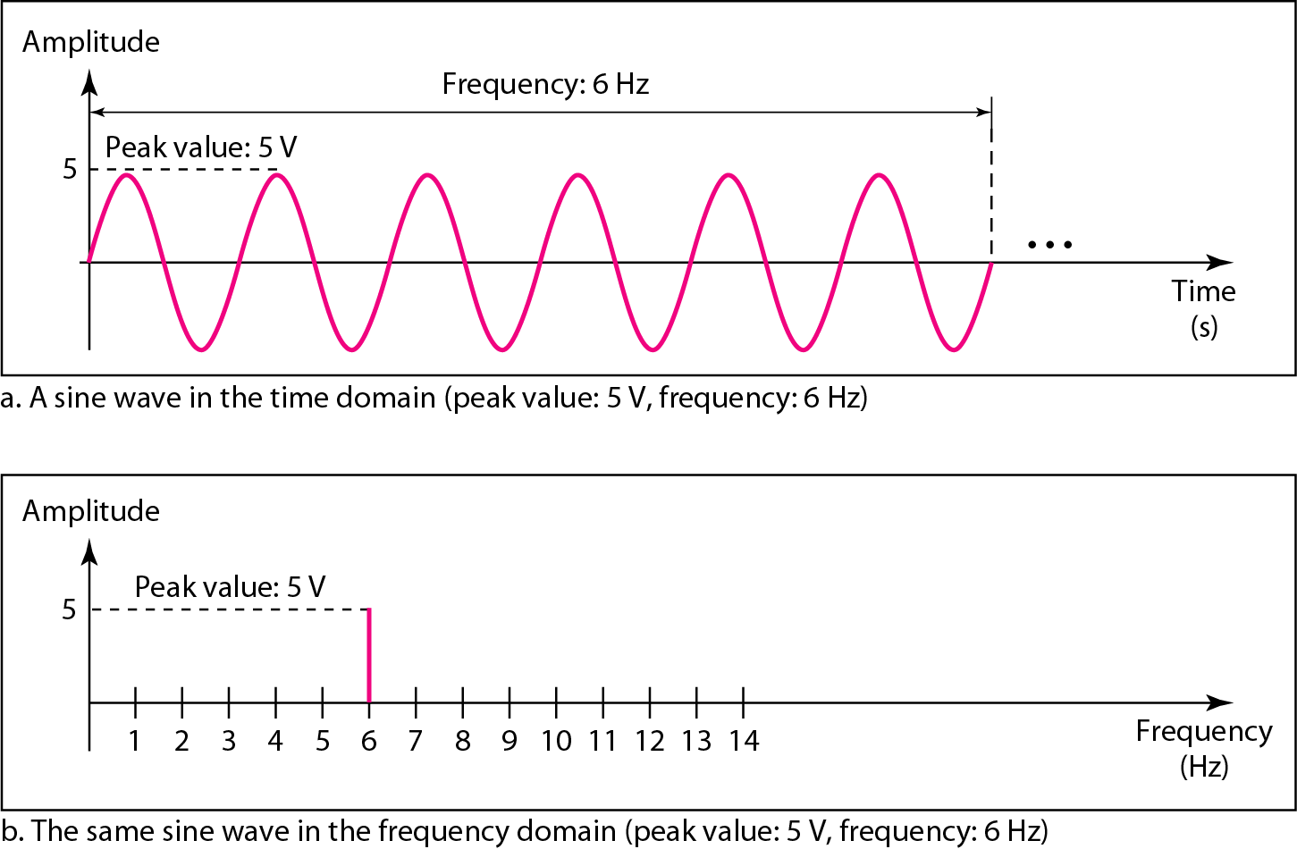
Figure 3.7 The time-domain and frequency-domain plots of a sine wave
3.21

Slide 22
Example 3.7
The frequency domain is more compact and useful when we are dealing with more than one sine wave. For example, Figure 3.8 shows three sine waves, each with different amplitude and frequency. All can be represented by three spikes in the frequency domain.
3.22

Slide 23
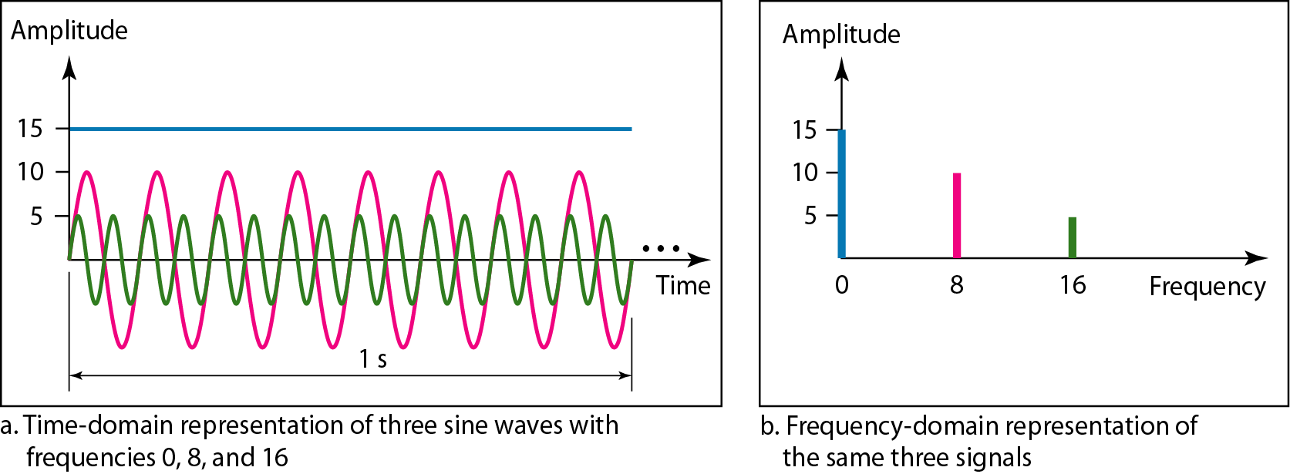
Figure 3.8 The time domain and frequency domain of three sine waves
3.23

Slide 24
Note
A single-frequency sine wave is not useful in data communications;
we need to send a composite signal, a signal made of many simple sine waves.
3.24

Slide 25
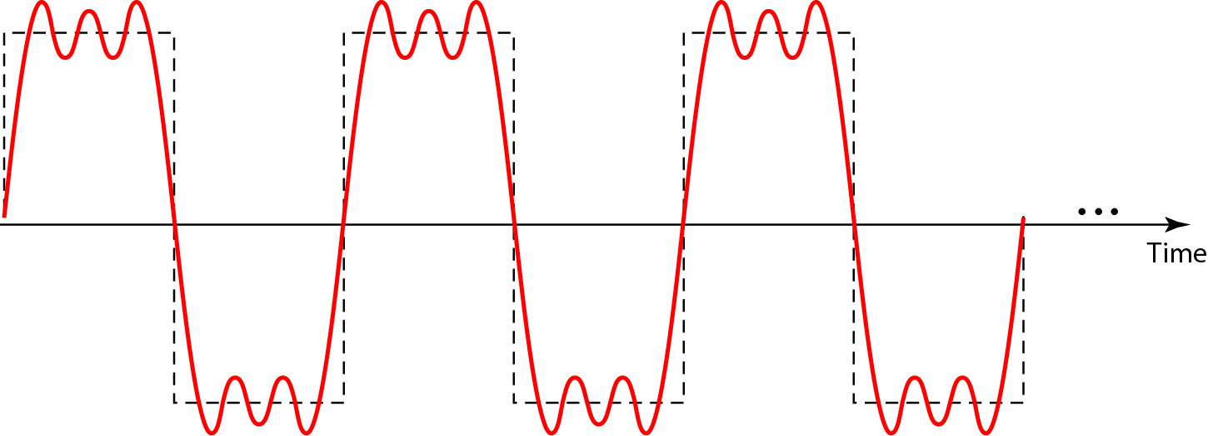
Figure 3.9 A composite periodic signal
3.25

Slide 26
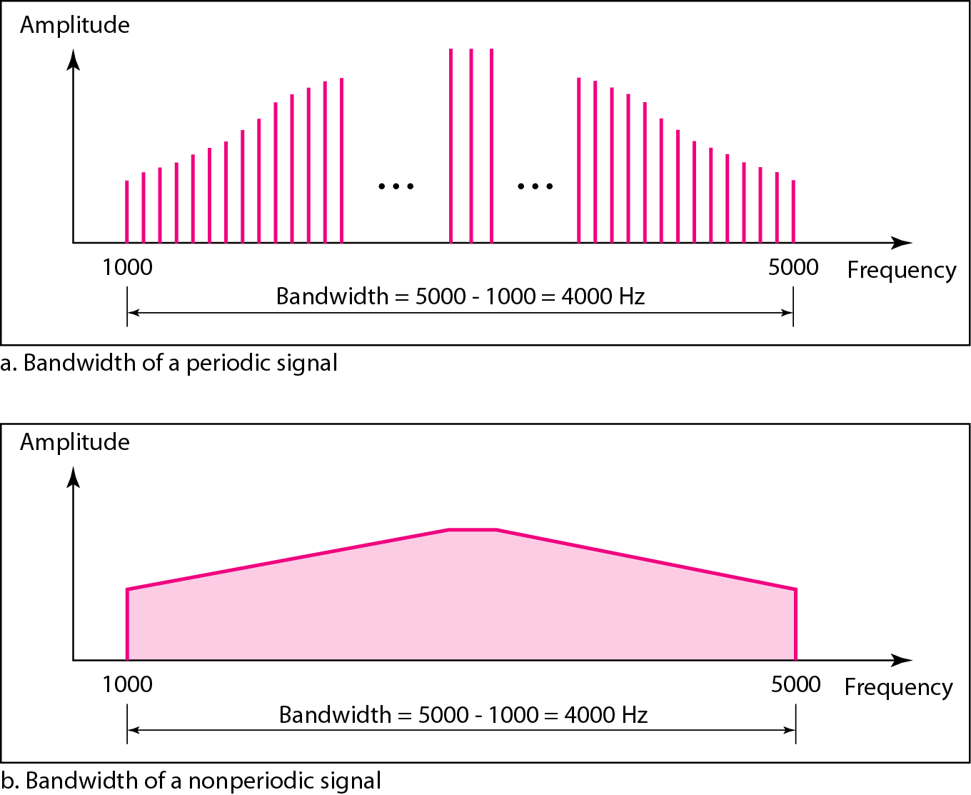
Figure 3.12 The bandwidth of periodic and nonperiodic composite signals
3.26

Slide 27

Example 3.10
If a periodic signal is decomposed into five sine waves with frequencies of 100, 300, 500, 700, and 900 Hz, what is its bandwidth? Draw the spectrum, assuming all components have a maximum amplitude of 10 V.
Solution
Let f_{h} be the highest frequency, f_{l} the lowest frequency, and B the bandwidth. Then
The spectrum has only five spikes, at 100, 300, 500, 700, and 900 Hz (see Figure 3.13).
3.27

Slide 28
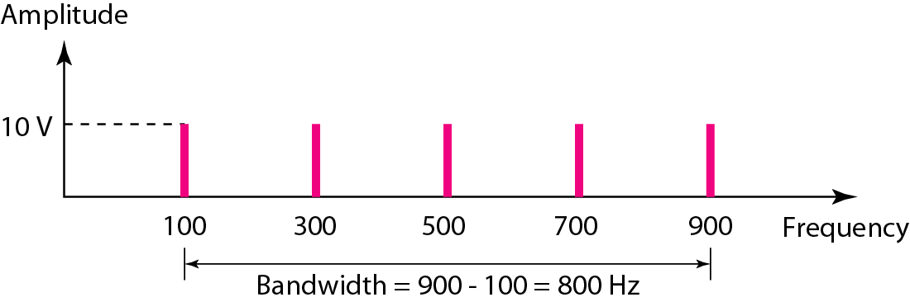
Figure 3.13 The bandwidth for Example 3.10
3.28

Slide 29
3-3 DIGITAL SIGNALS
In addition to being represented by an analog signal, information can also be represented by a digital signal. For example, a 1 can be encoded as a positive voltage and a 0 as zero voltage. A digital signal can have more than two levels. In this case, we can send more than 1 bit for each level.
Topics discussed in this section:
Bit Rate Bit Length Digital Signal as a Composite Analog Signal
Application Layer
3.29

Slide 30
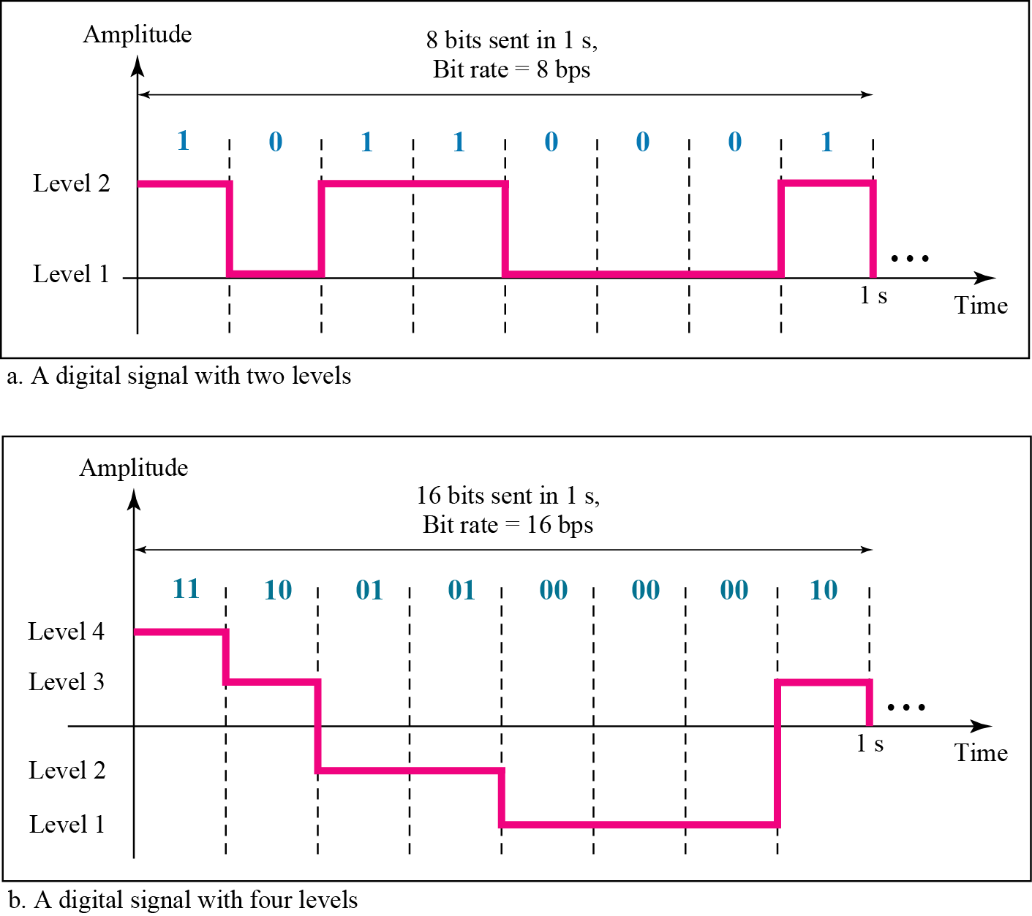
Figure 3.16 Two digital signals: one with two signal levels and the other with four signal levels
3.30

Slide 31
Example 3.16
A digital signal has eight levels. How many bits are needed per level? We calculate the number of bits from the formula
Each signal level is represented by 3 bits.
3.31

Slide 32
Example 3.17
A digital signal has nine levels. How many bits are needed per level? We calculate the number of bits by using the formula. Each signal level is represented by 3.17 bits. However, this answer is not realistic. The number of bits sent per level needs to be an integer as well as a power of 2. For this example, 4 bits can represent one level.
3.32

Slide 33
Example 3.18
Assume we need to download text documents at the rate of 100 pages per second. What is the required bit rate of the channel?
Solution
A page is an average of 24 lines with 80 characters in each line. If we assume that one character requires 8 bits, the bit rate is
3.33

Slide 34
Example 3.19
A digitized voice channel, as we will see in Chapter 4, is made by digitizing a 4-kHz bandwidth analog voice signal. We need to sample the signal at twice the highest frequency (two samples per hertz). We assume that each sample requires 8 bits. What is the required bit rate?
Solution
The bit rate can be calculated as
3.34

Slide 35
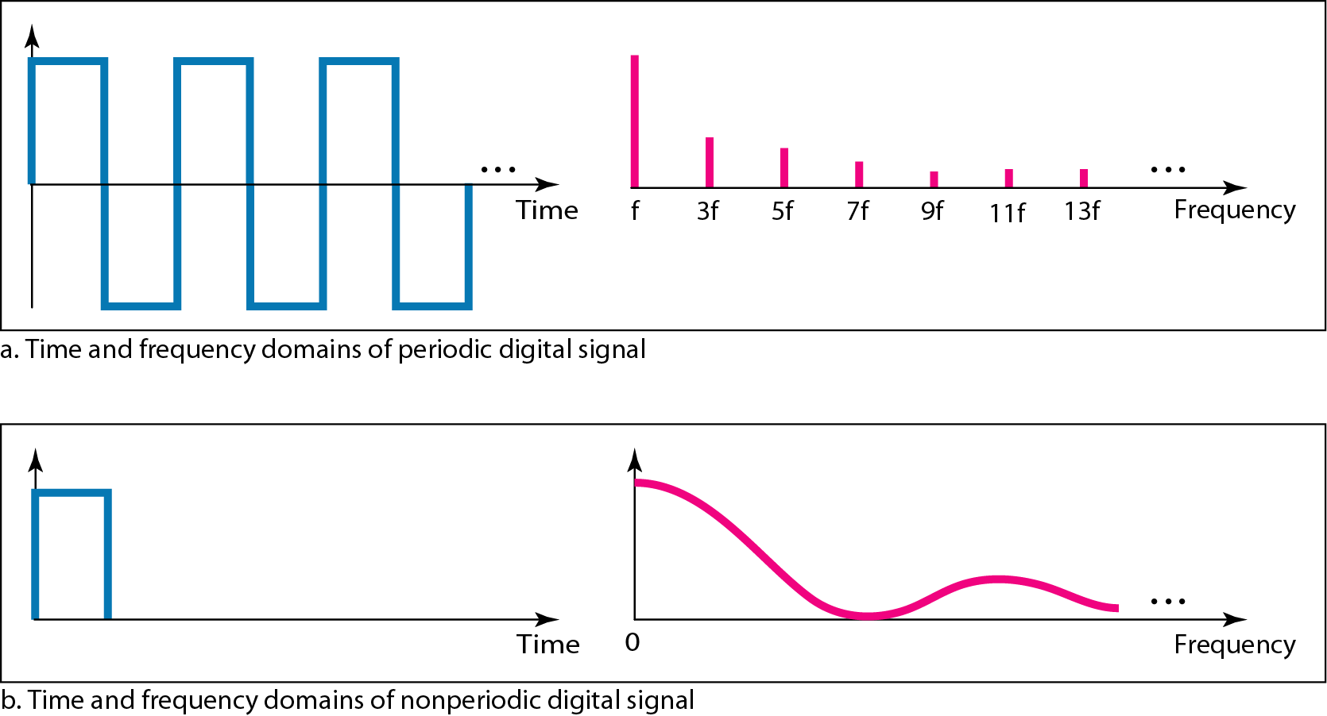
Figure 3.17 The time and frequency domains of periodic and nonperiodic digital signals
3.35

Slide 36
3-4 TRANSMISSION IMPAIRMENT
Signals travel through transmission media, which are not perfect. The imperfection causes signal impairment. This means that the signal at the beginning of the medium is not the same as the signal at the end of the medium. What is sent is not what is received. Three causes of impairment are attenuation, distortion, and noise.
Topics discussed in this section:
Attenuation Distortion Noise
3.36

Slide 37
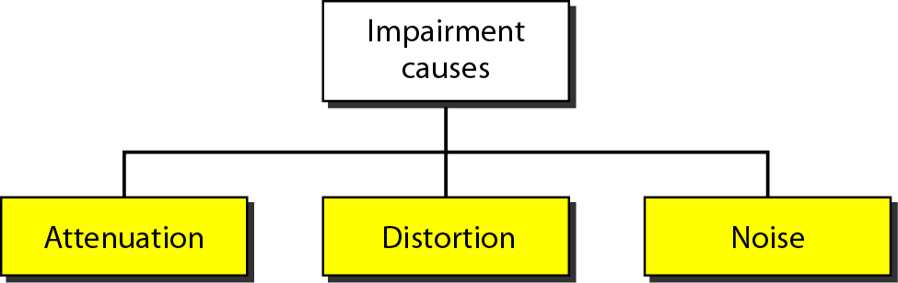
Figure 3.25 Causes of impairment
3.37

Slide 38
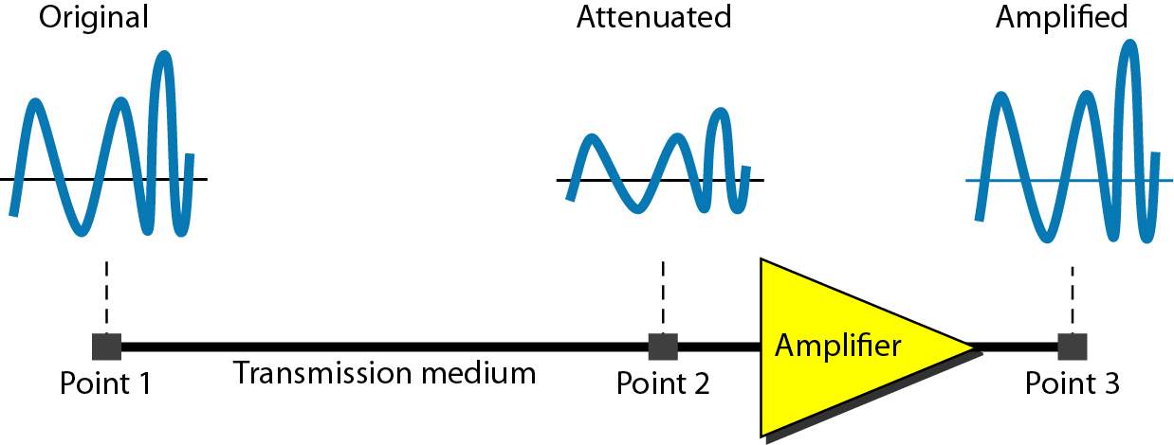
Figure 3.26 Attenuation
3.38

Slide 39

Example 3.26
Suppose a signal travels through a transmission medium and its power is reduced to one-half. This means that P₂ is (1/2)P₁. In this case, the attenuation (loss of power) can be calculated as
A loss of 3 dB (–3 dB) is equivalent to losing one-half the power.
3.39

Slide 40

Example 3.28
One reason that engineers use the decibel to measure the changes in the strength of a signal is that decibel numbers can be added (or subtracted) when we are measuring several points (cascading) instead of just two. In Figure 3.27 a signal travels from point 1 to point 4. In this case, the decibel value can be calculated as
3.40

Slide 41

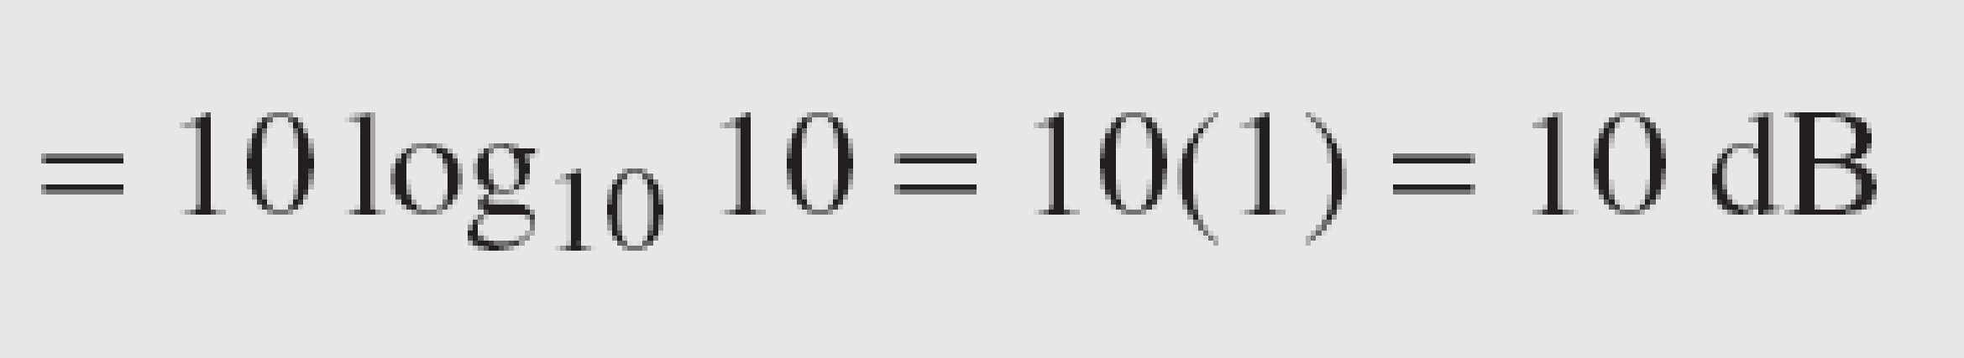
Example 3.27
A signal travels through an amplifier, and its power is increased 10 times. This means that P₂ = 10P₁ . In this case, the amplification (gain of power) can be calculated as
3.41

Slide 42
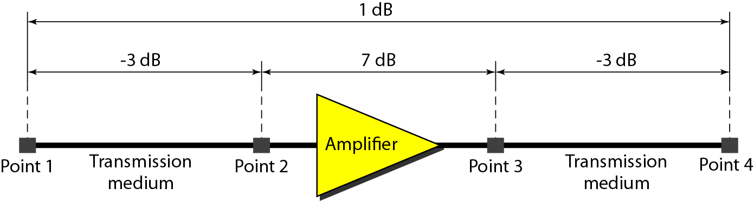
Figure 3.27 Decibels for Example 3.28
3.42

Slide 43
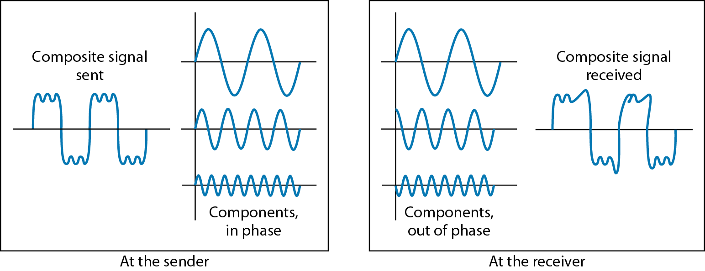
Figure 3.28 Distortion
3.43

Slide 44
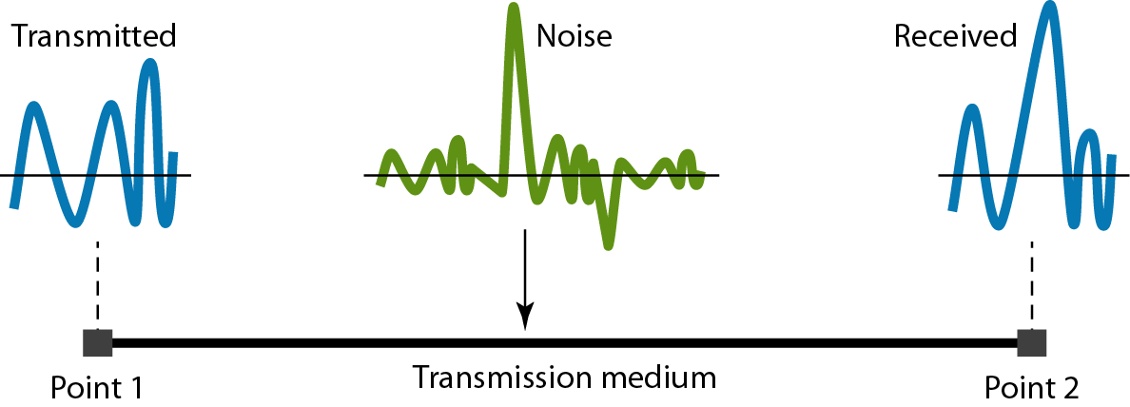
Figure 3.29 Noise
3.44

Slide 45
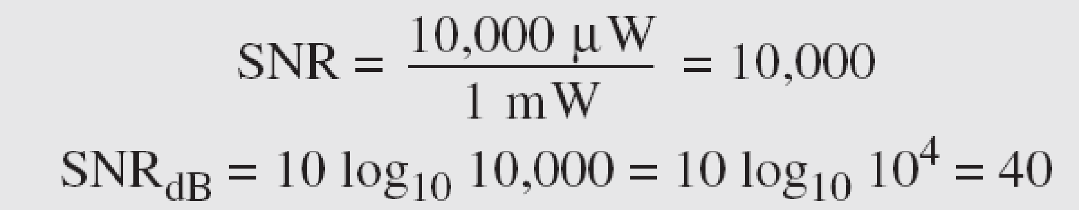
Example 3.31
The power of a signal is 10 mW and the power of the noise is 1 μW; what are the values of SNR and SNR_{dB} ?
Solution
The values of SNR and SNR_{dB} can be calculated as follows:
3.45

Slide 46
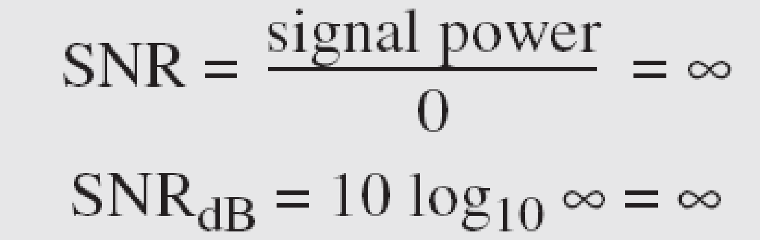
Example 3.32
The values of SNR and SNR_{dB} for a noiseless channel are
We can never achieve this ratio in real life; it is an ideal.
3.46

Slide 47
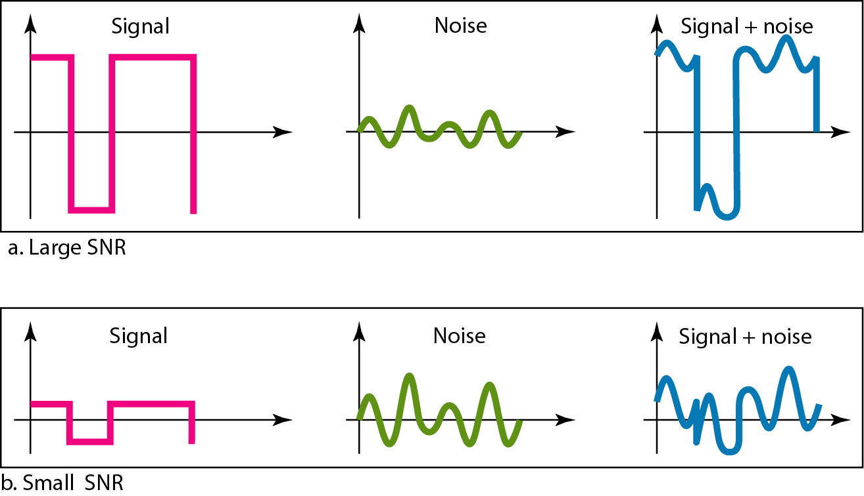
Figure 3.30 Two cases of SNR: a high SNR and a low SNR
3.47

Slide 48
3-5 DATA RATE LIMITS
A very important consideration in data communications is how fast we can send data, in bits per second, over a channel. Data rate depends on three factors:
1. The bandwidth available
2. The level of the signals we use
3. The quality of the channel (the level of noise)
Topics discussed in this section:
Noiseless Channel: Nyquist Bit Rate Noisy Channel: Shannon Capacity Using Both Limits
3.48

Slide 49
Note
Increasing the levels of a signal may reduce the reliability of the system.
3.49

Slide 50
Example 3.34
Consider a noiseless channel with a bandwidth of 3000 Hz transmitting a signal with two signal levels. The maximum bit rate can be calculated as
3.50

Slide 51
Example 3.35
Consider the same noiseless channel transmitting a signal with four signal levels (for each level, we send 2 bits). The maximum bit rate can be calculated as
3.51

Slide 52

Example 3.36
We need to send 265 kbps over a noiseless channel with a bandwidth of 20 kHz. How many signal levels do we need?
Solution
We can use the Nyquist formula as shown:
Since this result is not a power of 2, we need to either increase the number of levels or reduce the bit rate. If we have 128 levels, the bit rate is 280 kbps. If we have 64 levels, the bit rate is 240 kbps.
3.52

Slide 53
Example 3.37
Consider an extremely noisy channel in which the value of the signal-to-noise ratio is almost zero. In other words, the noise is so strong that the signal is faint. For this channel the capacity C is calculated as
This means that the capacity of this channel is zero regardless of the bandwidth. In other words, we cannot receive any data through this channel.
3.53

Slide 54
Example 3.38
We can calculate the theoretical highest bit rate of a regular telephone line. A telephone line normally has a bandwidth of 3000. The signal-to-noise ratio is usually 3162. For this channel the capacity is calculated as
This means that the highest bit rate for a telephone line is 34.860 kbps. If we want to send data faster than this, we can either increase the bandwidth of the line or improve the signal-to-noise ratio.
3.54

Slide 55
Example 3.39
The signal-to-noise ratio is often given in decibels. Assume that SNR_{dB} = 36 and the channel bandwidth is 2 MHz. The theoretical channel capacity can be calculated as
3.55

Slide 56


Example 3.40
For practical purposes, when the SNR is very high, we can assume that SNR + 1 is almost the same as SNR. In these cases, the theoretical channel capacity can be simplified to
For example, we can calculate the theoretical capacity of the previous example as
3.56

Slide 57
Example 3.41
We have a channel with a 1-MHz bandwidth. The SNR for this channel is 63. What are the appropriate bit rate and signal level?
Solution
First, we use the Shannon formula to find the upper limit.
3.57

Slide 58
Example 3.41 (continued)
The Shannon formula gives us 6 Mbps, the upper limit. For better performance we choose something lower, 4 Mbps, for example. Then we use the Nyquist formula to find the number of signal levels.
3.58

Slide 59
Note
The Shannon capacity gives us the upper limit; the Nyquist formula tells us how many signal levels we need.
3.59

Slide 60
3-6 PERFORMANCE
One important issue in networking is the performance of the network—how good is it? We discuss quality of service, an overall measurement of network performance, in greater detail in Chapter 24. In this section, we introduce terms that we need for future chapters.
Topics discussed in this section:
Bandwidth Throughput Latency (Delay)
3.60

Slide 61
Note
In networking, we use the term bandwidth in two contexts.
❏ The first, bandwidth in hertz, refers to the range of frequencies in a composite signal or the range of frequencies that a channel can pass.
❏ The second, bandwidth in bits per second, refers to the speed of bit transmission in a channel or link.
3.61

Slide 62
Example 3.42
The bandwidth of a subscriber line is 4 kHz for voice or data. The bandwidth of this line for data transmission
can be up to 56,000 bps using a sophisticated modem to change the digital signal to analog.
3.62

Slide 63

Example 3.44
A network with bandwidth of 10 Mbps can pass only an average of 12,000 frames per minute with each frame carrying an average of 10,000 bits. What is the throughput of this network?
Solution
We can calculate the throughput as
The throughput is almost one-fifth of the bandwidth in this case.
3.63

Slide 64
Example 3.46
What are the propagation time and the transmission time for a 2.5-kbyte message (an e-mail) if the bandwidth of the network is 1 Gbps? Assume that the distance between the sender and the receiver is 12,000 km and that light travels at 2.4 × 108 m/s.
Solution
We can calculate the propagation and transmission time as shown on the next slide:
3.64

Slide 65
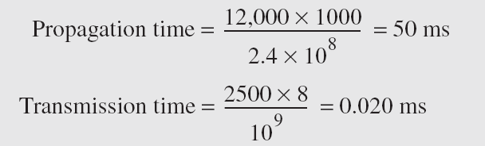
Example 3.46 (continued)
Note that in this case, because the message is short and the bandwidth is high, the dominant factor is the propagation time, not the transmission time. The transmission time can be ignored.
3.65

